Slide 1



Æther crypto solutions
26 May 2025
info@aethercrypto.ae | www.aethercrypto.ae | +44 7351 350690

Slide 2


Bitcoin & Mining theory
Æther Crypto Solutions

Slide 3

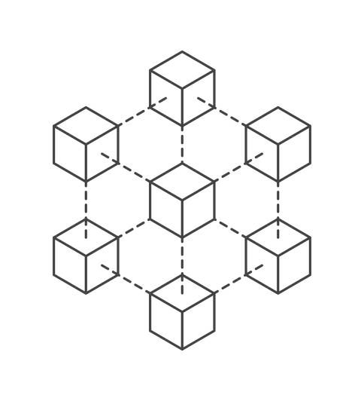

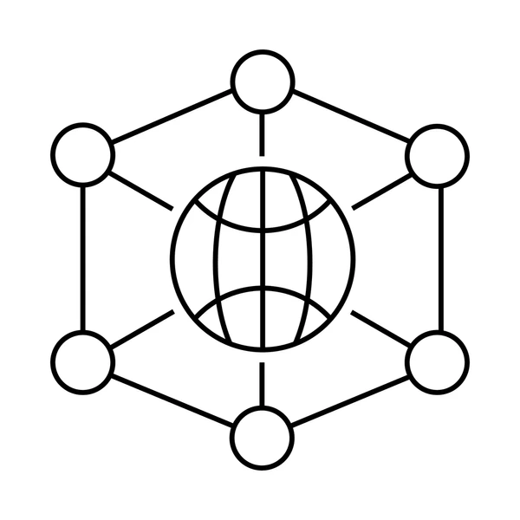
Bitcoin
What is Bitcoin?
How it Works
A cryptocurrency launched in 2009 by anonymous creator, Satoshi Nakamoto
Blockchain Technology
A public, tamper-proof ledger records every transaction
Limited Supply: Only 21 million Bitcoins will ever exist
Secured by cryptography and validated by a global network of computers
Mining
Specialised hardware solves complex puzzles to validate transactions
Decentralisation
No single entity controls Bitcoin. It is governed by code and a consensus among users and miners
Notes:
Why is bitcoin price rising
https://btcscan.org
https://www.blockchain.com/explorer
https://mempool.space

Slide 4
WHY is bitcoin mined
Mining is the process by which bitcoin transactions are validated and added to the public ledger which is called the blockchain. This introduces new coins through rewards.
Miners confirm and record Bitcoin transactions to prevent double transactions.
Large computational power protects the system from attacks as achieving over 50% control will require near impossible amounts of computing power for an attacker.
Anyone can mine bitcoin, ensuring decentralisation as no single entity controls the network.

Slide 5
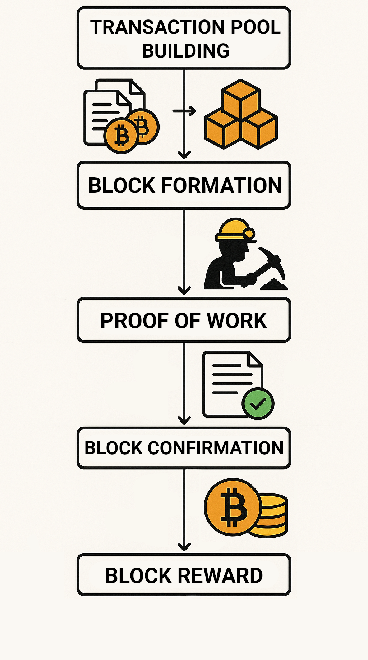
How is bitcoin mined
The process of mining is called proof of work – this is where miners solve a mathematical puzzle to validate transactions on the Bitcoin network.
This puzzle involves finding a hash (a unique 64-character string) that is compliant with the protocol.
The first miner to find this is rewarded with:
Newly created Bitcoins
Transaction Fees
This process requires huge amounts of computational power which requires large amounts of energy which increases in difficulty over time.
Notes:
\

Slide 6
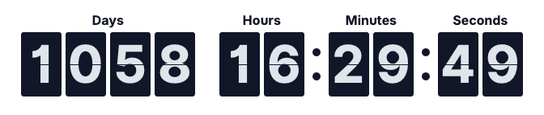
Bitcoin Difficulty & Halving
Difficulty
Halving
Adjusts every 2016 blocks (≈ 2 weeks)
Ensures blocks are mined roughly every 10 minutes
Increases as more miners join the network
Decreases if mining slows down
Keeps Bitcoin issuance stable and predictable
Ensures the last bitcoin is mined in the year 2140
Happens every 210,000 Blocks (≈ 4 years)
Cuts the reward per block in half (3.125 BTC to 1.5625 BTC)
Reduces new Bitcoin supply
Designed to mimic scarcity like gold
Drives long term price dynamics

Slide 7
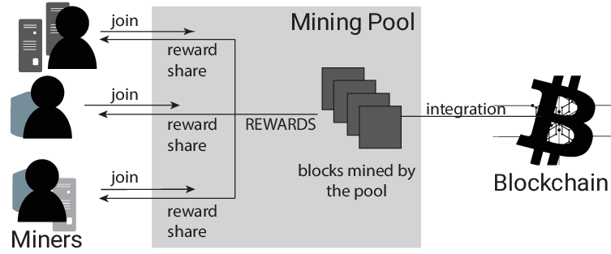
Mining pools
Bitcoin mining is comparable to purchasing lottery tickets
The higher the hash rate of a miner, the more tickets are purchased.
If operating alone, the probability of finding a block is near-zero, which leads to the potential of waiting months or years to make any income.
By joining a mining pool, miners combine their hash rates with each other and then distribute earnings equally.
This improves payout frequency and regularity leading to lots of small, predictable payments.
In return, pools charge a small fee of between 2-4%

Slide 8
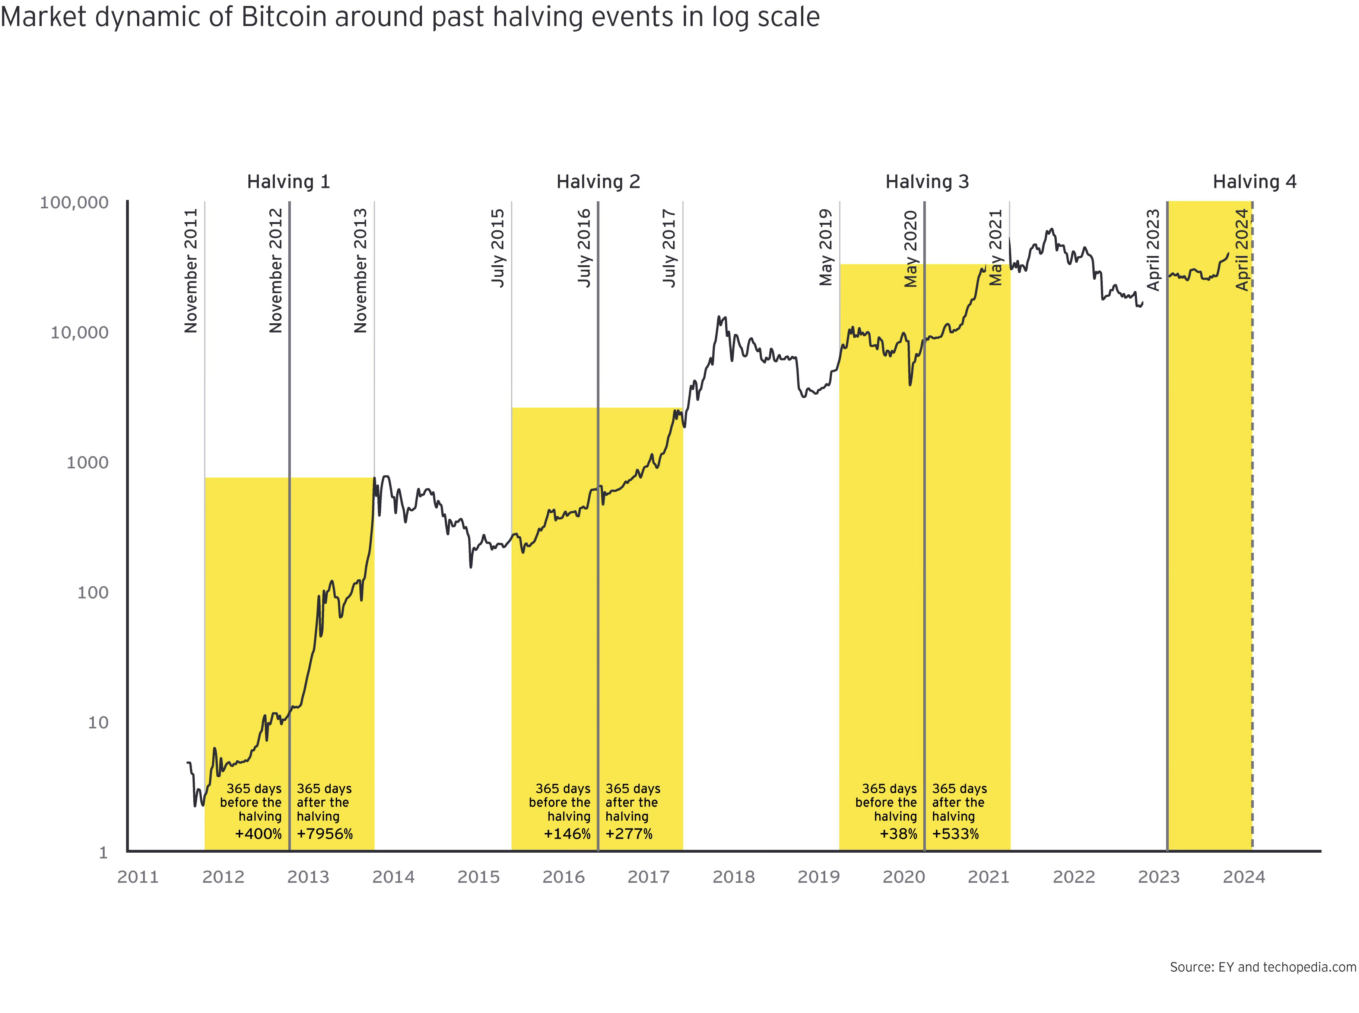
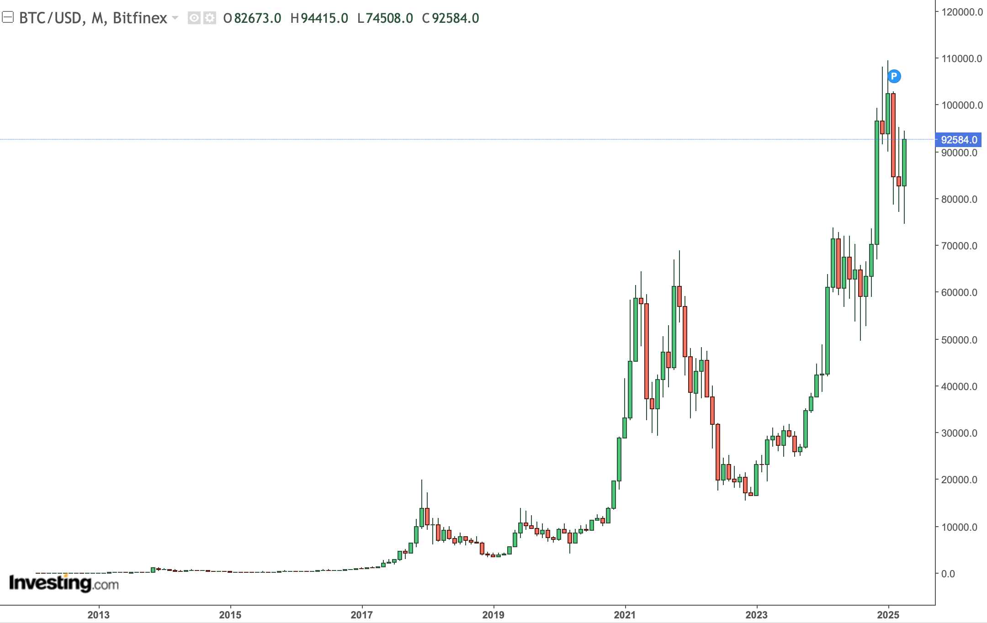
Historic Bitcoin performance
Bitcoin price shows cyclical growth tied to halving events
Rallies followed halvings about 1 year after the event
Despite high volatility, long term trend is remaining upward.
Notes:
Increase size? Zoom?
Discuss what to do when new model appears. What is current price difference between S19 and S21. What is the equipment devaluation

Slide 9
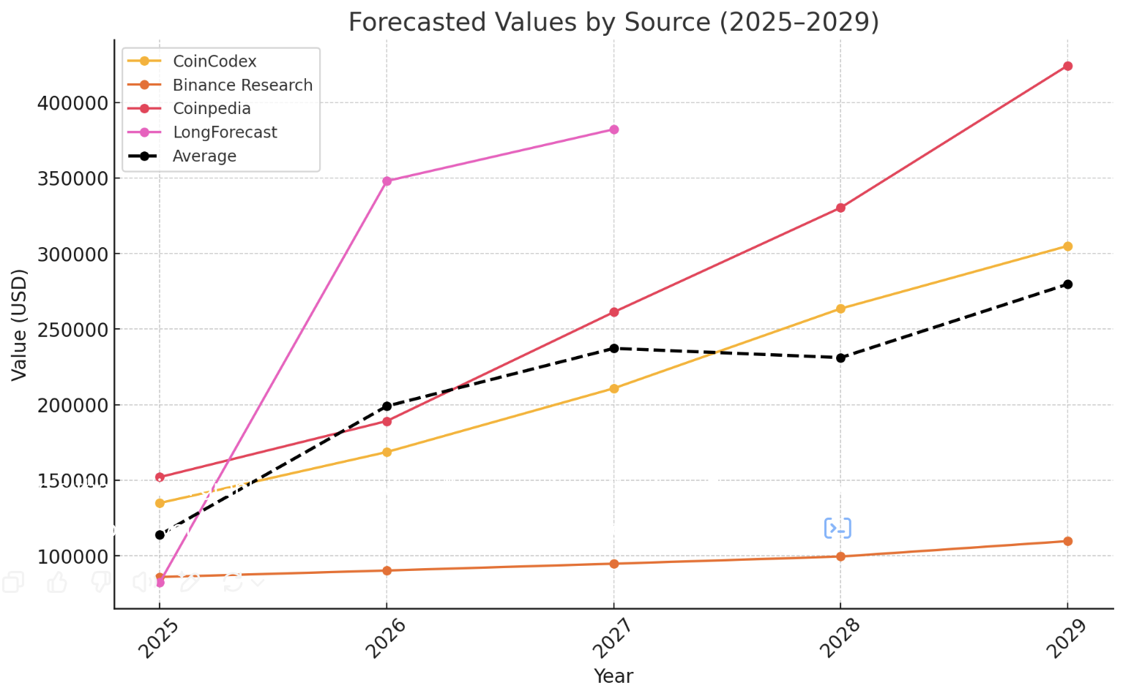
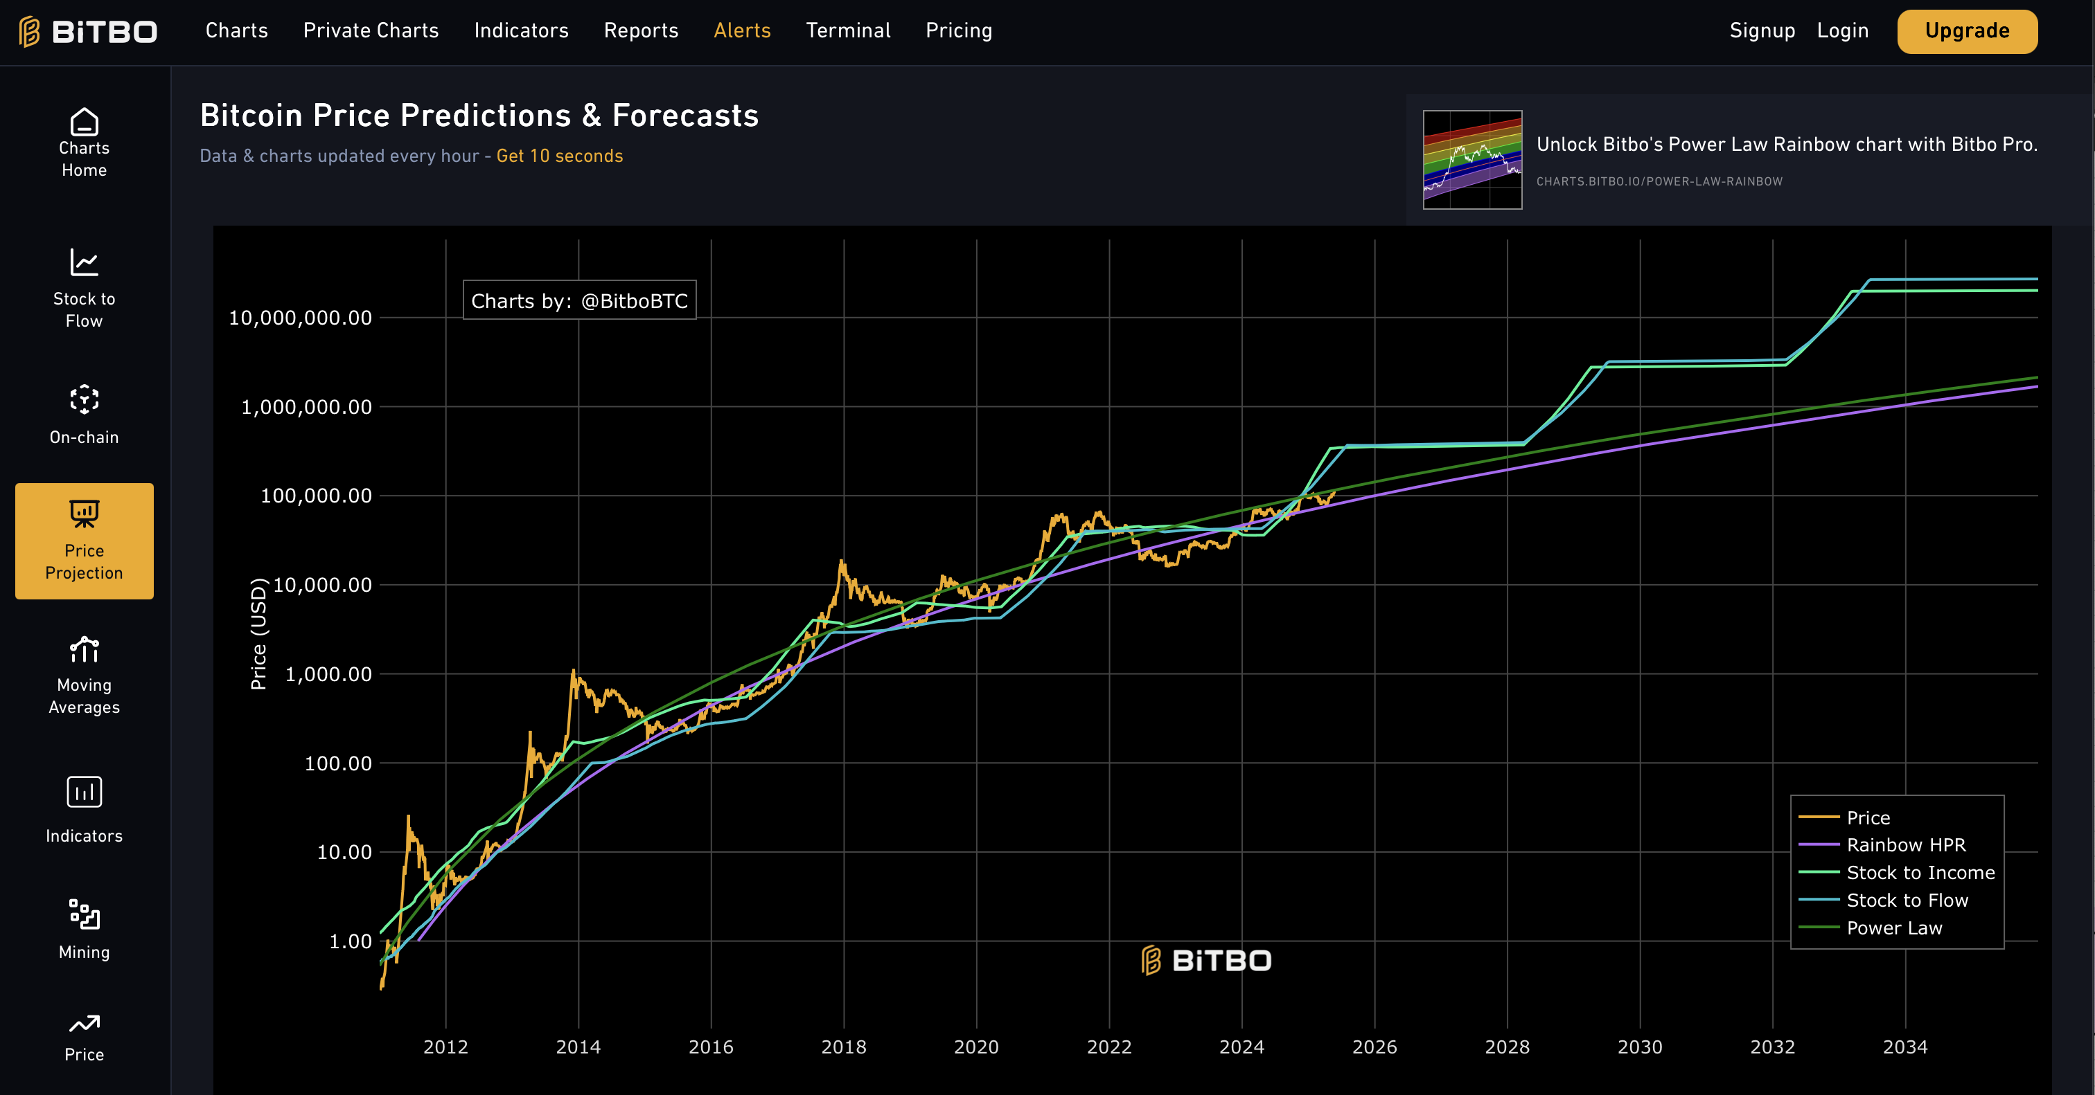
BITCOIN PREDICTIONS
H.C. Wainright - Raised BTC target to $225k by the end of 2025
Anthony Scaramucci - Predicts BTC to rise to $200k by end of 2025
Bitwise - Predicts BTC to hit $200k by end of 2025 with expectations of $500k if the United States Government establishes a strategic BTC reserve.
VanEck - Predicts BTC will reach $180k during 2025
Source | 2025 | 2026 | 2027 | 2028 | 2029
CoinCodex | $134,899 | $168,624 | $210,780 | $263,558 | $305,028
Binance Research | $85,920 | $90,216 | $94,726 | $99,463 | $109,658
Coinpedia | $152,031 | $189,127 | $261,222 | $330,361 | $424,399
LongForecast | $82,384 | $347,998 | $382,227
Average*** | $ 124,283.33 | $ 149,322.33 | $ 188,909.33 | $ 231,127.33 | $ 279,695.00

Slide 10




WHO ELSE IS involved?
1. BlackRock
World's largest asset manager with over $11.5 trillion USD.
Major shareholder in U.S.-based Bitcoin mining companies: Marathon Digital, Riot Platforms, CleanSpark, Cipher Mining, and TeraWulf.
2. Morgan Stanley
Invested in Bitcoin mining companies: Marathon Digital, Riot Platforms, and CleanSpark.
Investments in crypto firms like NYDIG, R3, and Securitize. ​
3. Fidelity Investments
Operates Fidelity Digital Assets, offering Bitcoin custody and trade execution.
Supports mining operations by investing in infrastructure and blockchain research.
Backed Hut 8 Mining and has connections to Argo Blockchain.
4. JPMorgan Chase
Does not mine Bitcoin, but provides banking services to miners.
Offers financial services to crypto mining firms in the U.S., such as Coinbase and Gemini.

Slide 11
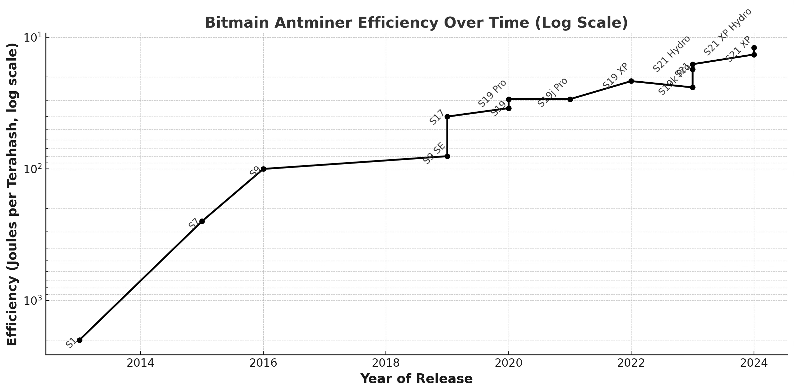
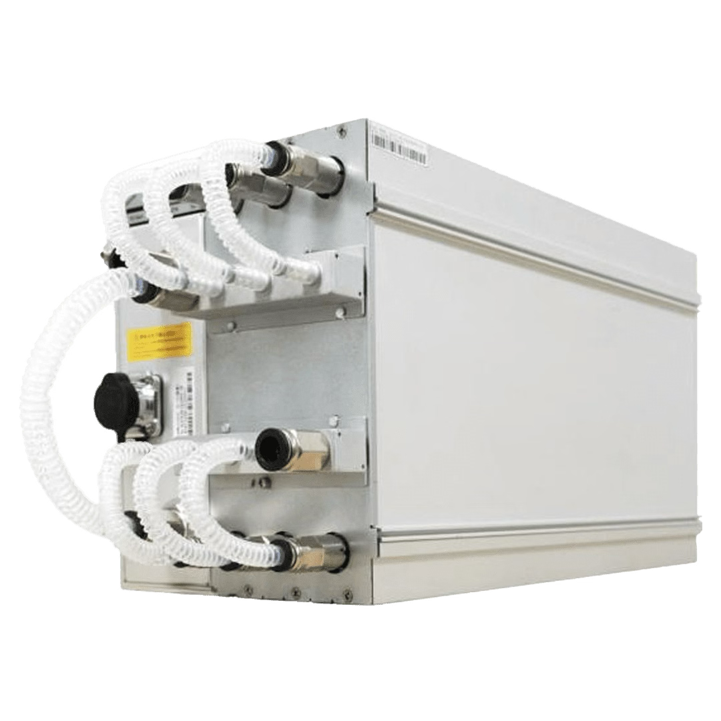
Bitmain antminer
Hardware Efficiency with time
Bitmain Technologies Ltd – Founded in 2013
Headquartered in Beijing with multiple R&D departments in multiple continents
The leading manufacturer in ASIC (Application Specific Integrated Circuit) cryptocurrency mining hardware
Has exponentially progressed in efficiency over time with each release (Hash rate per unit power)
Manufacture Air, Hydro and Immersion cooled mining hardware for multiple currencies
ANTMINER S21 Hydro
Notes:
ADD Zoom of image

Slide 12
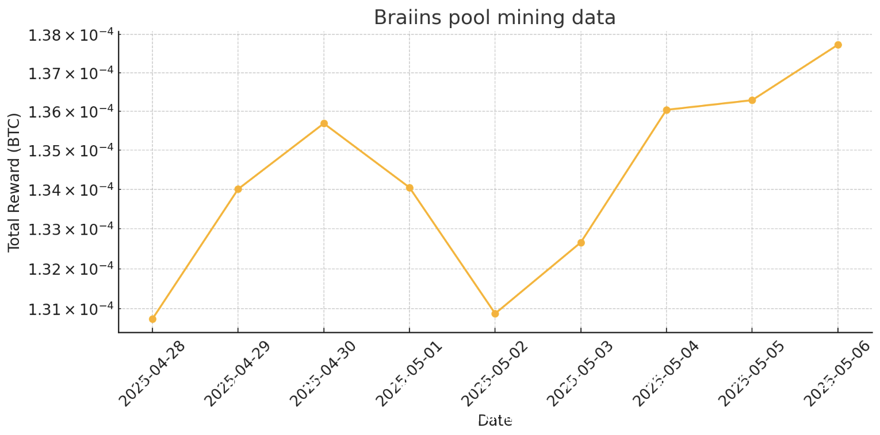
Our Testing Results
​Using a 270TH S21 XP (Air cooled) Miner, an average real hash rate of 257.18TH was produced with an average of 0.00013412BTC ($14.44) mined daily.

Slide 13
THE PROPOSITION
Æther Crypto Solutions

Slide 14





Who are Æther crypto solutions
Æther Crypto Solutions will be the name of a Limited Liability Company (LLC)
Registered in the UAE (currently ongoing)
Will not be part of the financial freezone due to limitations in land ownership for the technology sector
www.aethercrypto.ae
info@aethercrypto.ae
+44 7351 350690

Slide 15
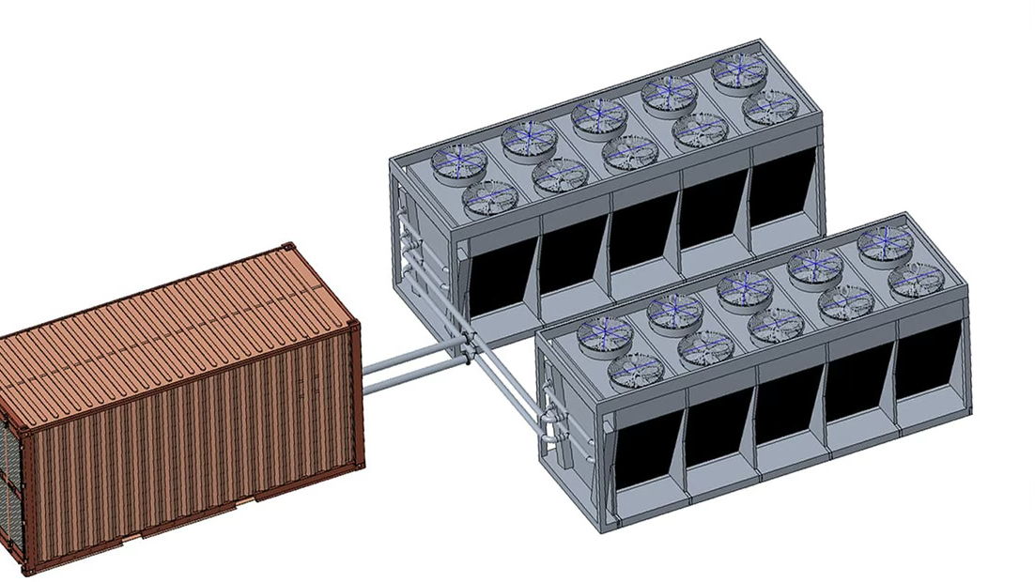
THE FACILITY
Housed in shipping containers to allow for easy relocation, high security and simplicity
Equipped with hydro-series S21 Antminer hardware (240 units per container)
1.4MW load per container with provisional ability to scale up to 5MW
Each container will have dedicated hybrid cooling towers to maintain safe temperatures for the miners
24/7 on call security will be provided with full CCTV monitoring. (Will expand with the project as necessary)
On call specialist technicians will be available to manage any hardware or software issues, repairs and replacements.

Slide 16
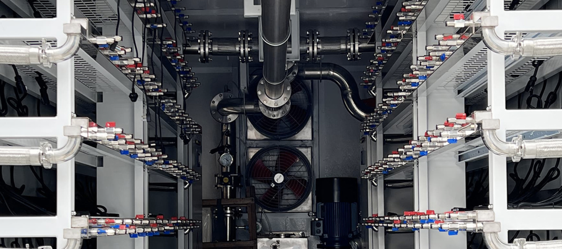
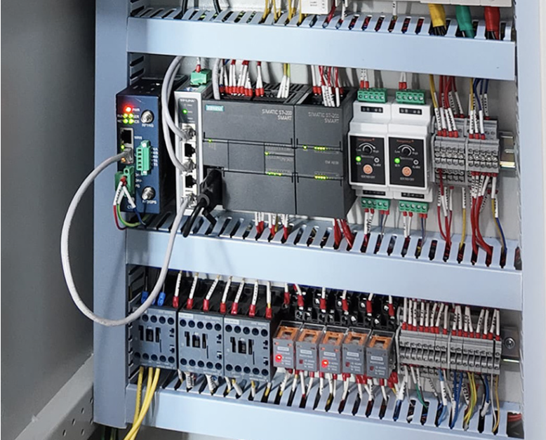
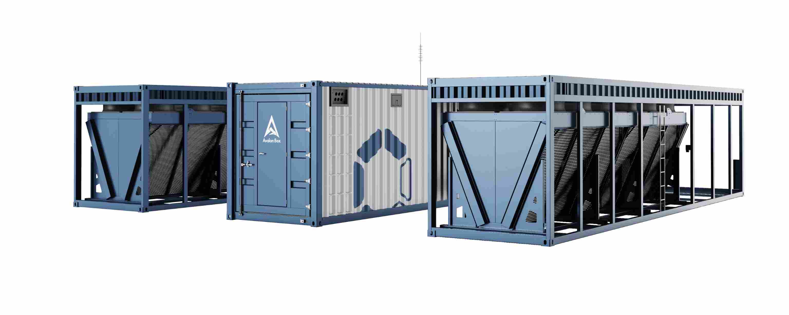
The Facility
Liquid Cooled
Hybrid Cooling Towers
Redundant Internet Connections
Fail-safe cooling measures
24/7 monitoring for miner optimisation & safety.

Slide 17
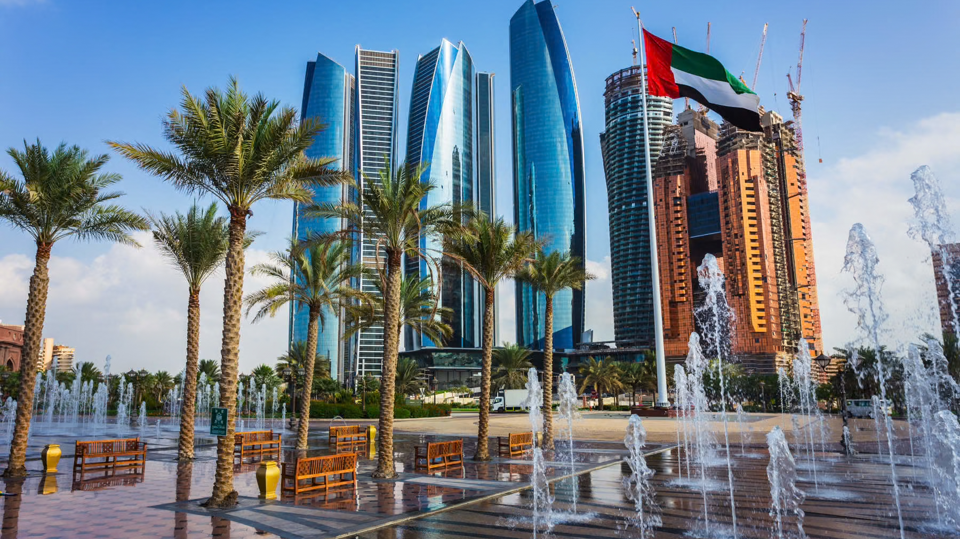



LOCATION
Location & Utilities
Lowest electricity rates in UAE: 0.2 AED/kWh (Abu Dhabi – TAQA)
~36% of global average rate for electricity (0.55 AED/kWh)
Fresh water: 0.0784 AED/m³ | Recycled water (ideal for cooling): 0.017 AED/m³
Climate Considerations
Average mean temp: 27°C (Min: 12°C, Max: 43°C)
Requires advanced thermal management: hybrid cooling towers with recycled water for cost efficiency
Security & Stability
Very low crime rate, strict enforcement
Strong cybersecurity laws, proactive national monitoring
Legal and regulated mining environment
Stable economy, supportive blockchain policies, reliable infrastructure

Slide 18
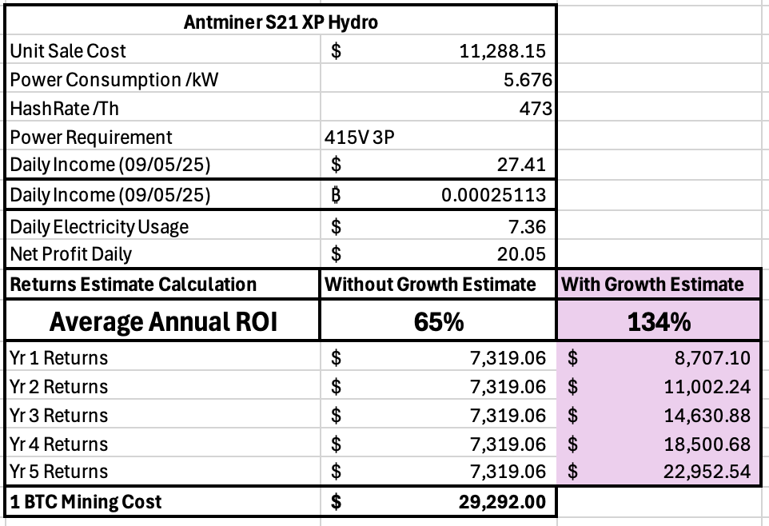
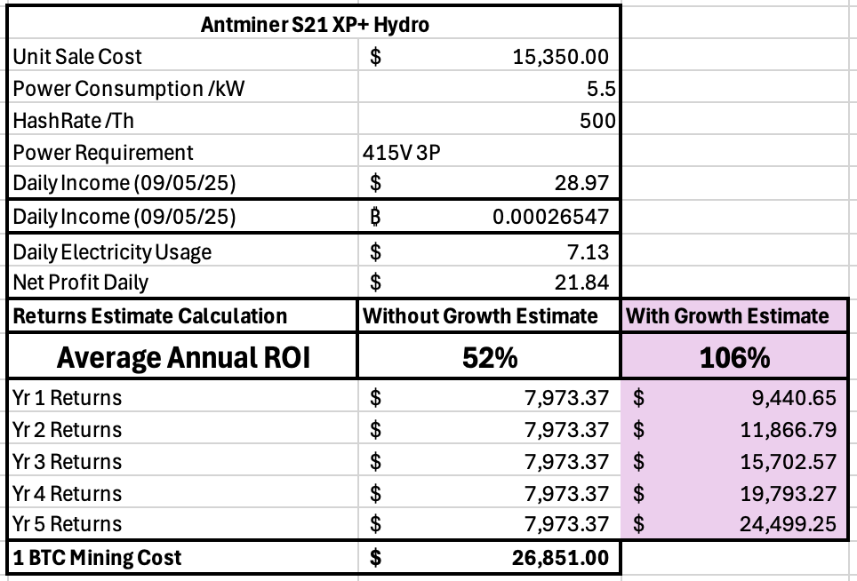
PREDICTED MINER INCOME (BTC-$109,600)

Slide 19
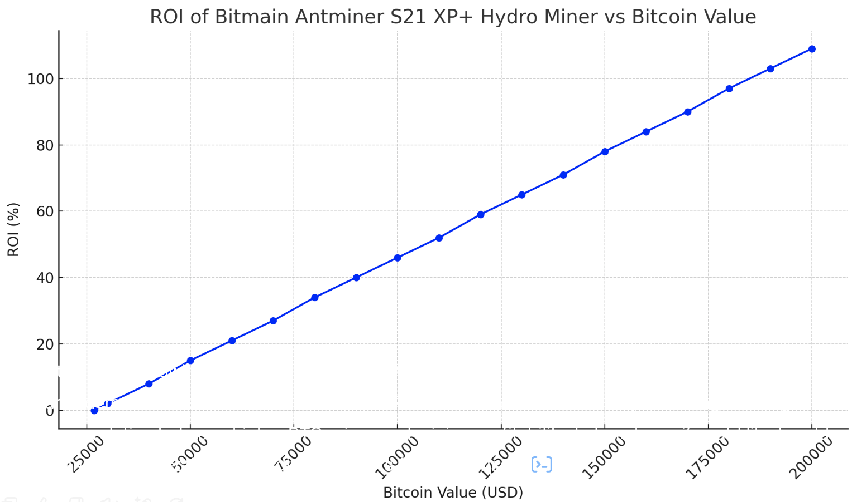
ROI with varying bitcoin value

Slide 20
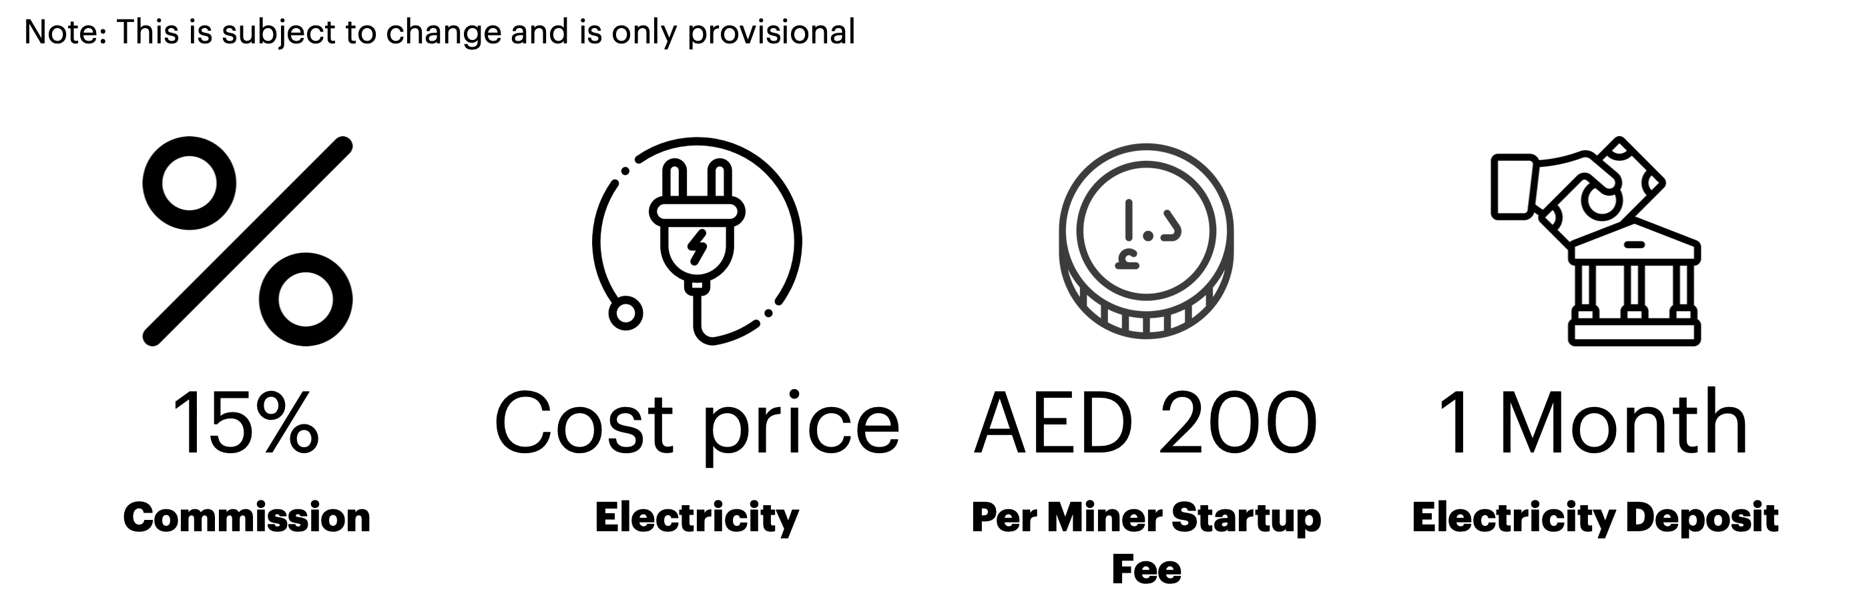
Fees
Note: This is subject to change and is only provisional

Slide 21








REPORTING & MANAGEMENT
A secure, members only portal will display live metrics on all of the following on a per client basis:
Electricity Charges
Outlet Temp.
Hash Rate
Inlet Temp.
Pool Fees
(updated every 24hrs)
Commission Fees
(updated every 24hrs)
Ambient Temp.
BTC Income
(updated every 24hrs)

Slide 22
Balance Settlement & Crypto Wallets
Electricity charges will be accrued in real time in AED and charged monthly at the end of a billing period in either AED or BTC
Earnings Settlements will be carried out monthly upon hitting a minimum transfer amount of 0.005 BTC
Earnings can be sent to any kind of wallet (hot or cold) in either BTC or currency of choice
Note: All conversions will be subject to fees as per the currency exchange used.

Slide 23



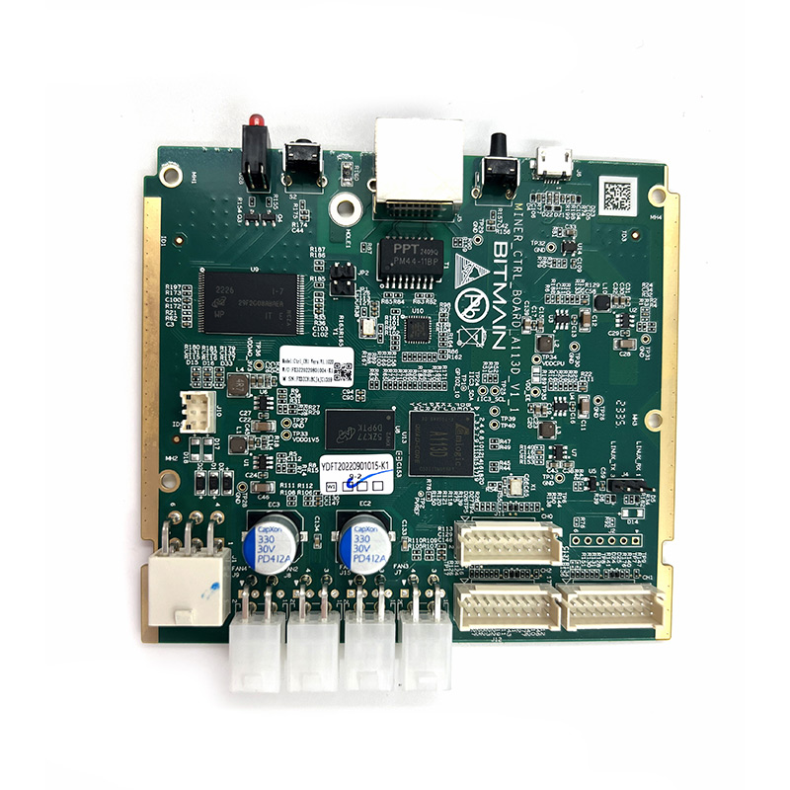
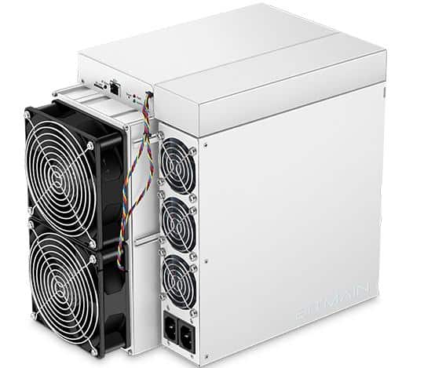
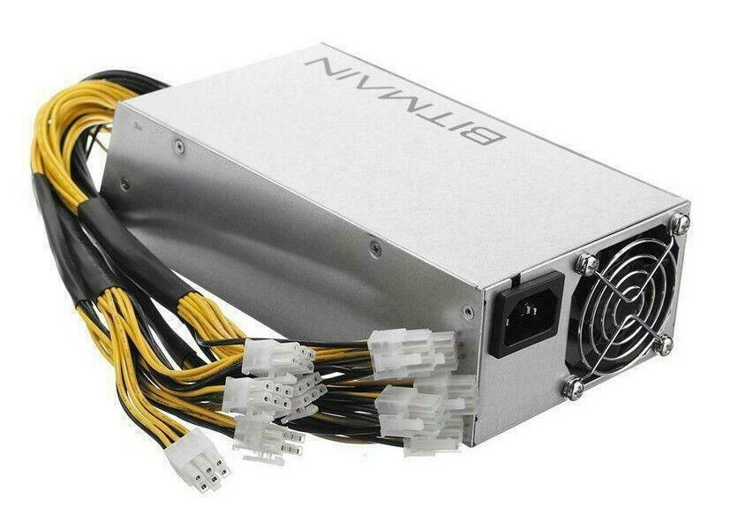
Warranty & Repairs
Warranty Coverage
Post Warranty Maintenance
All parts are swappable and easily replaceable by a technician
Repairs are available via 3rd party services or through Bitmain UAE
12 Month warranty provided on S21 Antminers
180 day warranty on replacement parts
Warranty starts from official shipment date
Longevity
Designed for 8 years of constant operation with minimal maintenance (fan replacement, dust cleaning etc.)

Slide 24




Our Proposal
Mining Package
Security & Support
24/7 CCTV Monitoring with on call security
Warranty & Repairs Managed by Æther Crypto Solutions
Purchase of 5+ Antminer S21 XP Hydro Miner slots
12-Month minimum contract (renewable)
Hardware Options
All-Inclusive Service
Buy through Æther Crypto Solutions or self-supply
After 12 months – continue, sell, or withdraw miners
S21 XP Hydro OR S21 XP+ Hydro
Full Farm Management
Pool Optimisation
Income Payouts
Ongoing Security
Miner Maintenance

Slide 25
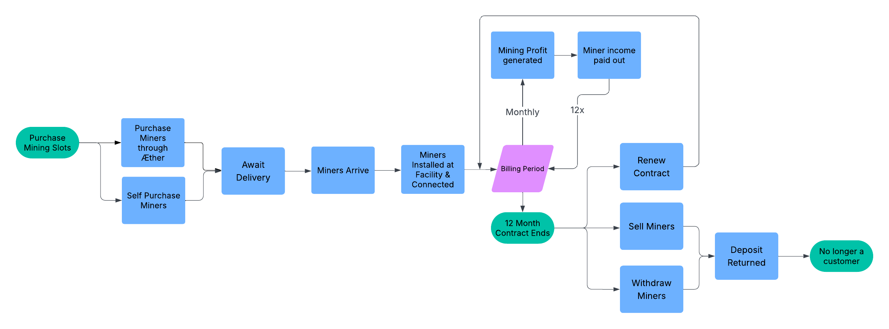
How the process looks
Note: This is subject to change and is only provisional

Slide 26
FUTURE OPPORTUNITIES
Æther Crypto Solutions

Slide 27








EXPANSION
Expansion Capacity
Altcoin Mining Roadmap
Phase 1 – Bitcoin only
Future – Evaluate Aleo, Litecoin, DOGE, Kaspa, and BTM
Strategy – Diversify and stay ahead of market trends to ensure long-term returns
Modularised design for easy expansion
240 miners per container
Relocatable & easy to connect to the grid
Cooling Flexibility
Ability to expand into air cooled miners
Ability to use immersion cooling technologies to further improve efficiency

Slide 28

Public Company Expansion

Slide 29
Any Questions?

Slide 30

Æther crypto solutions
Æther crypto solutions
info@aethercrypto.ae | www.aethercrypto.ae | *Insert UAE Phone*

